Slide 1
Chapter 7
Conflict and Cohesion in Groups
©2010, 2007, 2003 Pearson Education, Inc.

Slide 2
Conflict in Groups
Conflict
The disagreement and disharmony that occurs in groups when differences are expressed regarding group goals; member ideas, behavior, and roles; or group procedures and norms
©2010, 2007, 2003 Pearson Education, Inc.

Slide 3
Conflict definition?
Interdependence: (would be something else such as a competition, an argument, a contest, etc) each party wants to "get their own way”
Perception: the incompatibility of goals may (not) be real, but the parties see it as such.
©2010, 2007, 2003 Pearson Education, Inc.

Slide 4
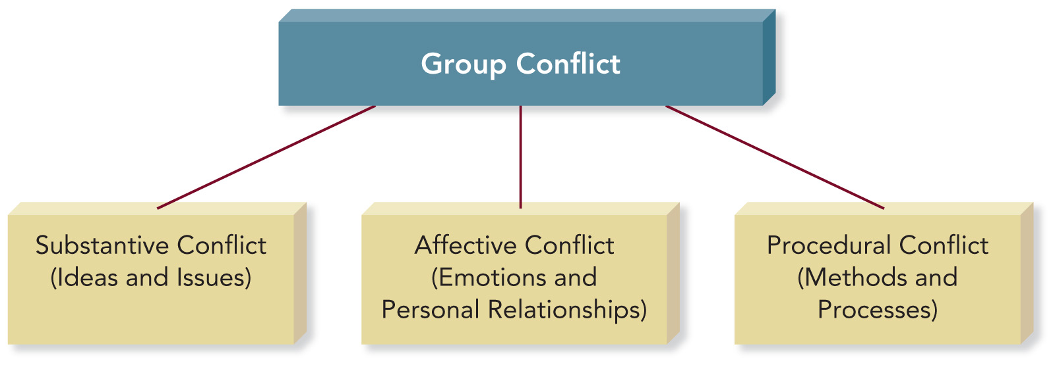
Sources of Conflict
©2010, 2007, 2003 Pearson Education, Inc.

Slide 5
Match the Types of Conflict
_c_ Substantive
conflict
_b_ Affective
conflict
_a_ Procedural
conflict
Disagree work logistics, for example who gets what to do
Different personal issues: personality, communication styles, and member beliefs and values.
Disagree about work content and outcomes
©2010, 2007, 2003 Pearson Education, Inc.

Slide 6
PowerPoint Quiz
Members of a civic association’s committee on community safety disagree on whether to install more expensive street lighting throughout the development. What type of conflict is the group experiencing?
  Affective
  Collaborative
  Substantive
  Competitive
  Procedural
©2010, 2007, 2003 Pearson Education, Inc.

Slide 7
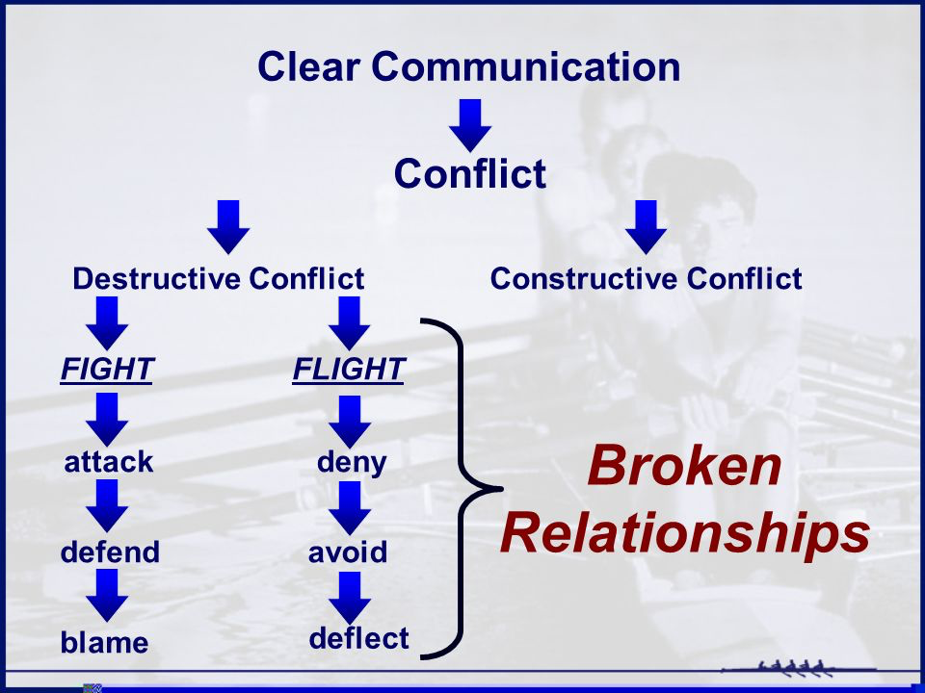
©2010, 2007, 2003 Pearson Education, Inc.

Slide 8
Case 1
A married couple is planning how to spend Christmas with each of their retired parents. One could suggest, and the other agree, that they to alternate years (compromise), or they could each make proposals until they had settled on an agreement, like Eve with one family and Day with the other (negotiation).
©2010, 2007, 2003 Pearson Education, Inc.

Slide 9
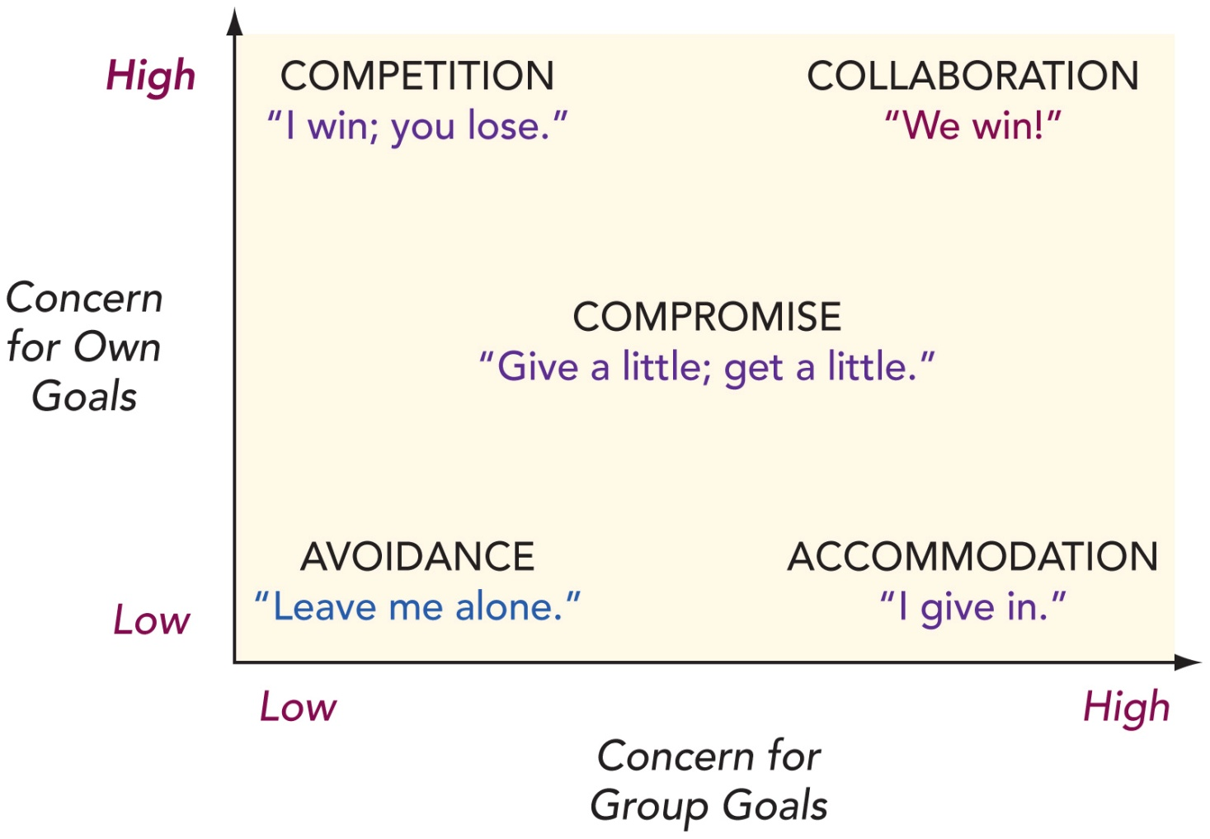
Five Basic Conflict Styles https://www.youtube.com/watch?v=hv9FEuk4Mhk
©2010, 2007, 2003 Pearson Education, Inc.

Slide 10
Avoidance Conflict Style
Members are unable or unwilling to accomplish their own goals or contribute to achieving the group’s goal.
Avoidance fails to address the problem and can increase group tensions.
©2010, 2007, 2003 Pearson Education, Inc.

Slide 11
Accommodation Conflict Style
Members give in to other members at the expense of their own goals.
Members believe that giving in helps even when the group would benefit from more analysis and discussion.
©2010, 2007, 2003 Pearson Education, Inc.

Slide 12
Competition Conflict Style
Group members are more concerned with their own goals than with meeting the needs of the group.
Competition may be characterized by hostility, ridicule, and personal attacks.
©2010, 2007, 2003 Pearson Education, Inc.

Slide 13
Compromise Conflict Style
Members give up some goals in order to achieve others.
Members accept losses in exchange for gaining something else.
Better options may be missed if group only uses this style.
©2010, 2007, 2003 Pearson Education, Inc.

Slide 14
Collaboration Conflict Style
Members search for new solutions that will achieve both individual goals and the goals of the group.
Effective collaboration requires a lot of time and energy for discussions in which all members fully participate.
©2010, 2007, 2003 Pearson Education, Inc.

Slide 15
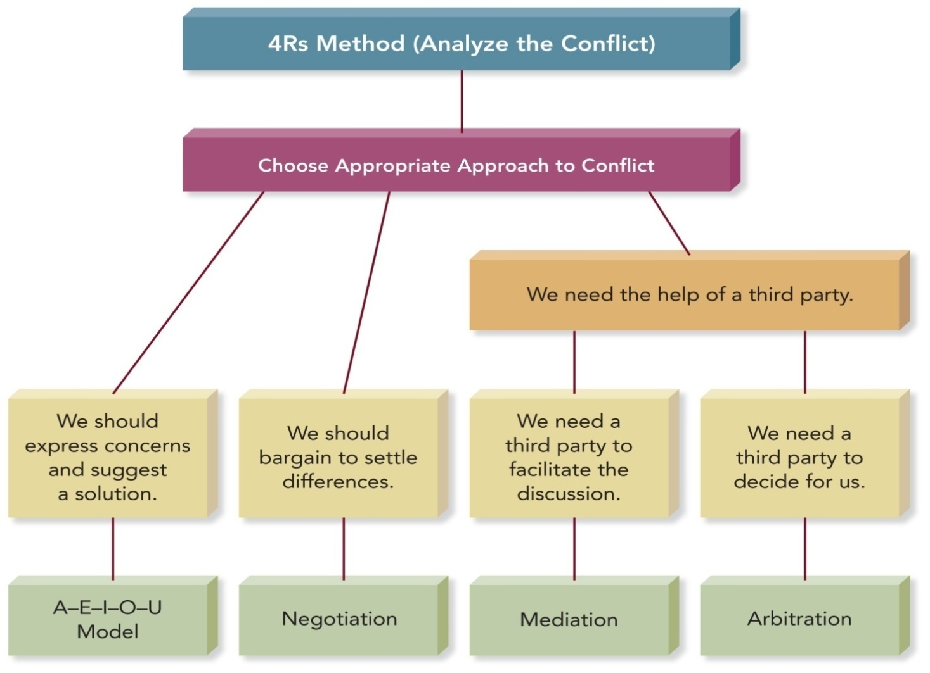
Conflict Management Strategies
©2010, 2007, 2003 Pearson Education, Inc.

Slide 16
The 4Rs Method
The 4Rs Method for Analyzing a Conflict
Reasons. What are the reasons for or causes of the conflict?
Reactions. How are group members reacting to one another?
Results. What are the consequences of the group’s current approach to the conflict?
Resolution. What are the available methods for resolving the conflict?
©2010, 2007, 2003 Pearson Education, Inc.

Slide 17
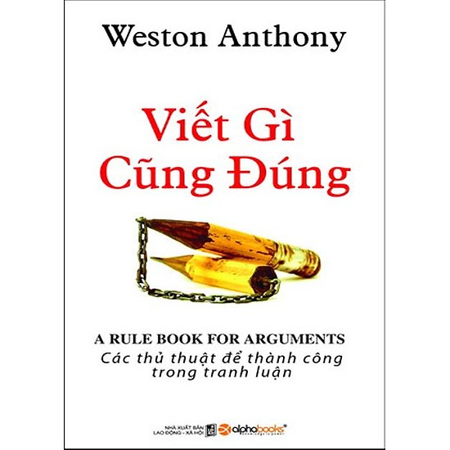
The A-E-I-O-U Method
A-E-I-O-U Method of Conflict Resolution
A – Assume other members mean well.
E – Express your feelings.
I – Identify what you want to happen.
O – Outcomes you expect are made clear.
U – A mutual Understanding is achieved.
©2010, 2007, 2003 Pearson Education, Inc.

Slide 18
The A-E-I-O-U Method
A-E-I-O-U Method of Conflict Resolution
A – Assume other members mean well.
E – Express your feelings.
U – A mutual Understanding is achieved.
I – Identify what you want to happen.
O – Outcomes you expect are made clear.
©2010, 2007, 2003 Pearson Education, Inc.

Slide 19
A-E-I-O-U Method of Conflict Resolution
A – Assume other members mean well.
E – Express your feelings.
©2010, 2007, 2003 Pearson Education, Inc.

Slide 20
3.U–mutual Understanding is achieved
What is a bird?
What is drug?
What is abortion?
©2010, 2007, 2003 Pearson Education, Inc.

Slide 21
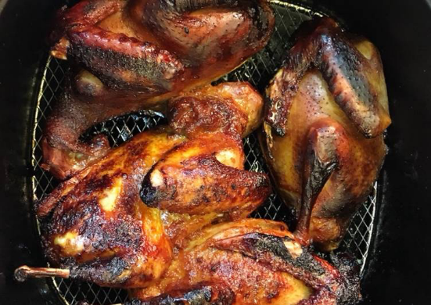
U – A mutual Understanding is achieved.
A bird is ….
I – Identify what you want to happen.
Sơn invite us meal of bird
O – Outcomes you expect are made clear.
Sơn choose the restaurant
Sơn & you order the dish
Sơn pay for the meal (include water)
Sơn pick you from home to the restaurant

Slide 22
Negotiation
A process of bargaining in order to settle differences or reach solutions.
Principled negotiation:
  separates people from the problem.
  focuses on group interests, not positions.
  generates a variety of possible solutions.
  insists on objective criteria.
©2010, 2007, 2003 Pearson Education, Inc.

Slide 23
Conflict Mediation
Employs the services of an impartial third party who guides, coaches, and encourages disputants through negotiation to successful resolution and agreement
William D. Kimsey, Rex M. Fuller, and Bruce C. McKinney,
Mediation and Conflict Management: General Mediation Manual
©2010, 2007, 2003 Pearson Education, Inc.

Slide 24
PowerPoint Quiz
All of the following are mediation strategies for resolving conflict constructively EXCEPT:
  Show strength and conviction by supporting your own position.
  Speak to be understood rather than win.
  Focus on your own perspective rather than criticizing others’ behavior.
  Explore ideas in new ways.
  Recognize that there are many perspectives rather than only two points of view.
©2010, 2007, 2003 Pearson Education, Inc.

Slide 25
Adapting to Differences
Culture: Members from cultures that value conformity and collectivism are less likely to express disagreement than those from cultures that place a higher value on individualism.
Gender: Women tend to avoid conflict; men and women differ in what is expected of them during conflicts.
©2010, 2007, 2003 Pearson Education, Inc.

Slide 26
Group Cohesion
Cohesion is the mutual attraction that holds members of a group together
Cohesive groups have:
High levels of interaction.
A supportive communication climate.
A desire to conform to group expectations.
The use of creative and productive approaches.
Satisfied members.
©2010, 2007, 2003 Pearson Education, Inc.

Slide 27
Enhancing Group Cohesion
  Establish a group identity and traditions.
  Emphasize teamwork.
  Recognize and reward contributions.
  Respect group members.
©2010, 2007, 2003 Pearson Education, Inc.

Slide 28
Groupthink
Groupthink
The deterioration of group effectiveness that results from in-group pressure
Highly cohesive groups are at greater risk of succumbing to groupthink.
Irving Janis identifies 8 symptoms and expressions of groupthink.
©2010, 2007, 2003 Pearson Education, Inc.

Slide 29
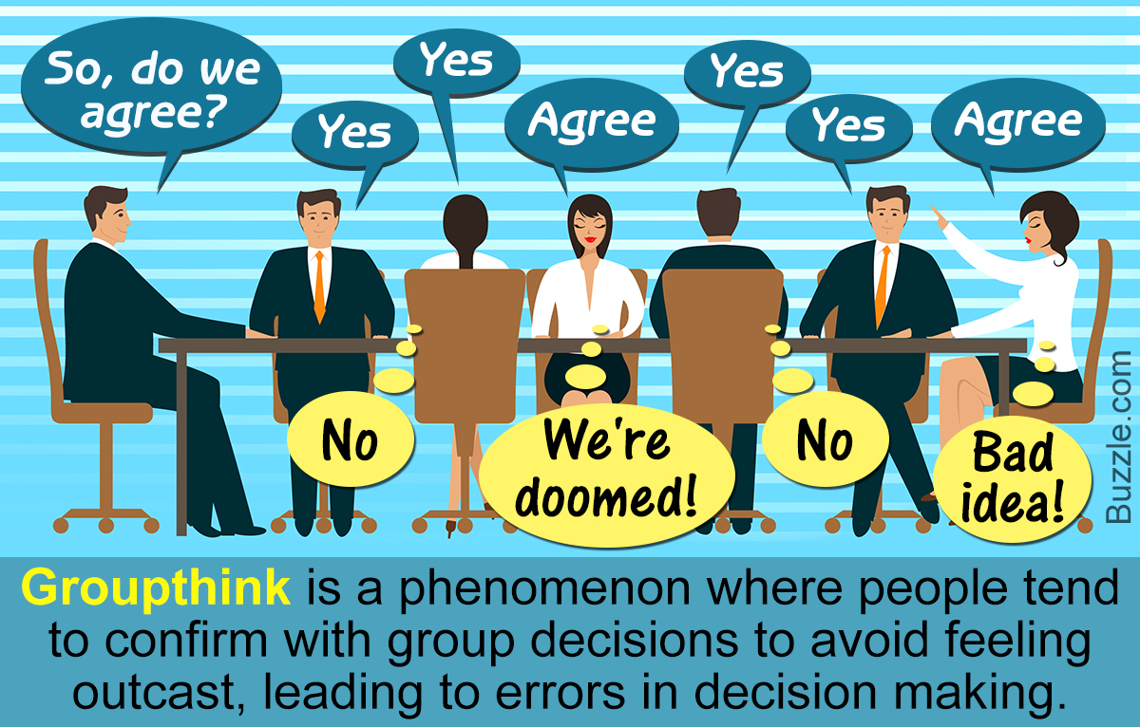
©2010, 2007, 2003 Pearson Education, Inc.

Slide 30
8 Groupthink Symptoms
Invulnerability: Overly confident; takes big risks – risk of time – quality – score
Rationalization: Makes excuses, ignores warnings
Morality: Ignores ethical and moral issues
Stereotyping Outsiders: Considers others too weak or stupid to cause trouble
©2010, 2007, 2003 Pearson Education, Inc.

Slide 31
8 Groupthink Symptoms
Self-Censorship: Unwilling to disagree; doubts their own concerns
Pressure on Dissenters: Pressures members to agree
Illusion of Unanimity: Believes everyone agrees
Mindguarding: Shields members from adverse information or opposition
©2010, 2007, 2003 Pearson Education, Inc.

Slide 32
Strategies for Avoiding Groupthink
Ask all members to serve as critical evaluators.
Assign several members to work on the same problem independently.
Discuss the group’s progress with someone outside the group.
Invite an expert to join a meeting and encourage constructive criticism.
Before finalizing a decision, give members a second chance to express doubts.
©2010, 2007, 2003 Pearson Education, Inc.

Slide 33
Adapting to Differences
Gender: Women tend to avoid conflict; men and women differ in what is expected of them during conflicts.
Culture: Members from cultures that value conformity and collectivism are less likely to express disagreement than those from cultures that place a higher value on individualism.
©2010, 2007, 2003 Pearson Education, Inc.

